Slide 1
Governing Board Overview
2026

Slide 2
LF Energy Overview and Governance

Slide 3
What is LF Energy?
LF Energy is the community for digital experts to collaborate on open industrial-grade technology platforms and agile standards that accelerate the energy transition.
We are part of the Linux Foundation, the largest shared technology investment in the world.

Slide 4
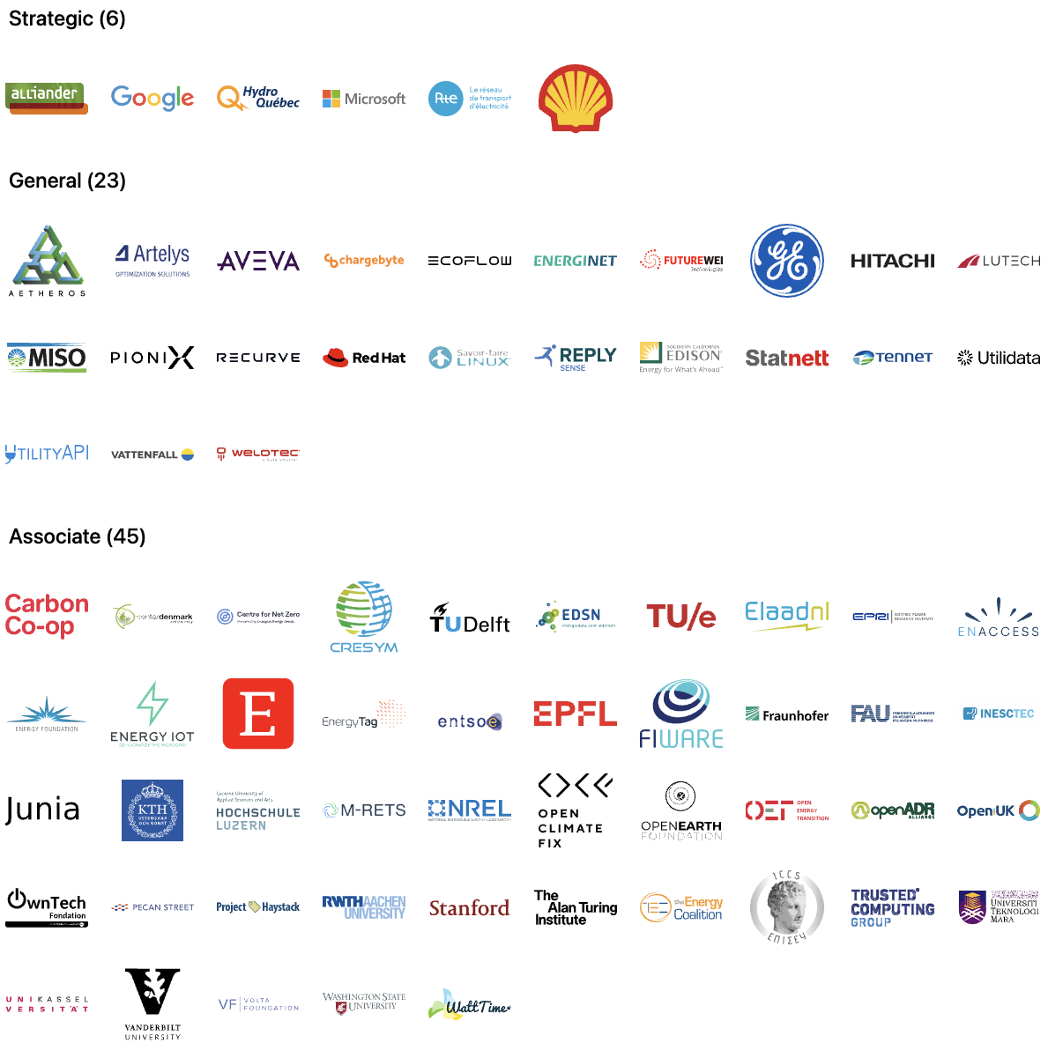
Members
Notes:
Source: https://landscape.lfenergy.org/embed/embed.html?base-path=&classify=category&key=lf-energy-member&headers=true&category-header=false&category-in-subcategory=false&title-uppercase=false&title-alignment=left&title-font-family=sans-serif&title-font-size=24&style=clean&bg-color=%23ffffff&fg-color=%23000000&item-modal=false&item-name=false&size=md&items-alignment=left

Slide 5
We’re a nonprofit, but not separately incorporated
The LF Energy Foundation is part of the the Linux Foundation and is not a separate legal entity
Therefore, the LF Energy Foundation Governing Board is not a corporate board of directors, and is not subject to corporate law statutes (e.g., those that govern fiduciary duties and how corporate boards of directors must operate)
The powers and duties of the Governing Board are set forth in the LF Energy Foundation Charter

Slide 6
Governance at a Glance
Fiduciary Governance - Membership driven
Technical Governance - Open to all
Governing Board
Technical Advisory Council (TAC)
Budget Committee
LF Energy Standards and Specifications (LFESS)
Steering Committee
Technical Projects
Working Groups/SIGs
Marketing Advisory Committee (MAC)
Standards
Working Groups

Slide 7
Key Governing Bodies and Committees
Business & Marketing Leadership
Governing Board (Governing Board)
Budget Committee
Legal Committee
Marketing Advisory Committee
Technical Leadership
Technical Advisory Council (TAC)
You can review the TAC meeting information and upcoming schedule and join the mailing list
Hosted Projects and Working Groups

Slide 8
Governing Board
Responsibilities

Slide 9
Governing Board Responsibilities
The Governing Board’s responsibilities include:
Approving the LF Energy budget, directing the use of funds to advance the mission of the LF Energy Foundation;
Directing marketing and outreach efforts;
Providing financial governance overall;
Voting on other decisions that come before the Governing Board.
Additional responsibilities are described in Section 3 of the LF Energy Foundation Charter.

Slide 10
What the Governing Board is NOT responsible for
The Governing Board does not make technical decisions for LF Energy Foundation other than working with the TAC to set the overall scope for the LF Energy Foundation.
The Governing Board is not responsible for overseeing day-to-day operations of LF Energy Foundation. This is the responsibility of the foundation staff.

Slide 11
Governing Board Chairperson
Duties of the Governing Board Chairperson include:
Oversee the day-to-day operational decisions of the LF Energy Foundation.
Work with the foundation staff to prepare the agenda for Governing Board meetings.
Be a spokesperson for the LF Energy Foundation and the Governing Board, as needed
See Section 3(d) of the LF Energy Foundation Charter for more information about the chairperson role.

Slide 12
Governing Board Operations

Slide 13
Governing Board Composition
The Governing Board voting members consist of:
One representative appointed from each Strategic member; and
General member elected representatives (if any)
The TAC Chairperson
See Section 3(a) of the LF Energy Foundation Charter for more information about composition.

Slide 14
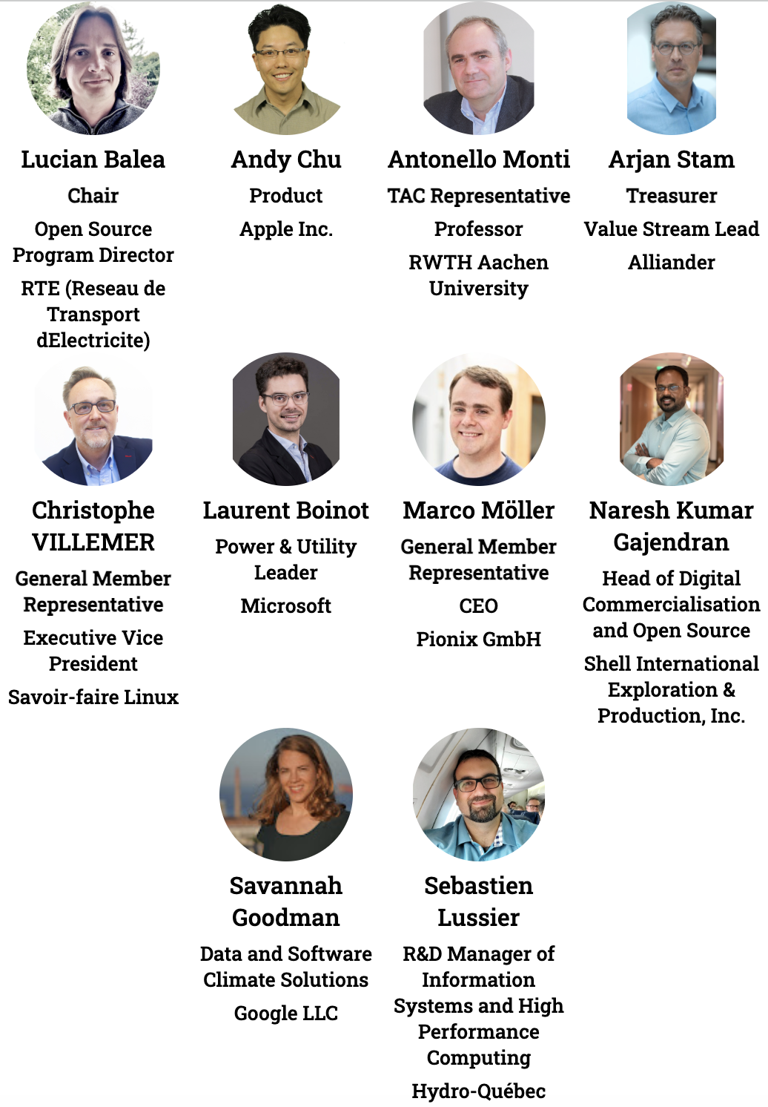
Governing Board
voting representatives
Notes:
https://jmertic.github.io/committee-gallery/lf-energy-foundation-governing-board
Zoom to fit

Slide 15
Governing Board Meetings

Slide 16
Meeting Cadence
The Governing Board has monthly virtual regular meetings, generally on the first Wednesday of each month.
Format for the meetings alternates between a formal business meeting and strategy session.
At the formal business meetings, voting will often take place.
For the strategy meetings, the Governing Board will align on a topic to discuss at the previous business meeting.
In rare and exceptional circumstances (e.g., in an emergency situation), an additional ad hoc special meeting of the Governing Board may be convened.
To request a special meeting, please email your request the Executive Director and Governing Board Chair, and they will decide whether a special meeting is necessary or the proposed agenda item can be discussed by email or at the next regular meeting.

Slide 17
Governing Board Meeting Schedule for 2025
Planned meetings of the Governing Board for 2025 - all meetings to be held at 8:00 am US Pacific Time/5:00 pm Central European Time on the first Wednesday of the month unless noted in italics.
Regular Meeting
8 January
5 March
7 May
2 July
9 September*
5 November
* subject to change pending LFE Summit timing
Strategic Meeting
5 February
2 April
4 June
6 August
1 October
3 December

Slide 18
How to propose an agenda item
If you would like to propose an agenda item for discussion at a Governing Board meeting, please submit your proposal to the LF Energy Foundation Executive Director & the Governing Board Chair.
Please include in your request:
A description of the topic
Board resolution or discussion-only item
Requested amount of time to discuss the item
For a regular Governing Board meeting, please submit your proposed agenda item at least 10 days prior to the meeting.
For a Strategy Session, please submit your proposed agenda item at least 30 days prior to the meeting.

Slide 19
Proposing an agenda item (continued)
Please be patient. Our board meeting agendas are often very full. If we cannot accommodate your request in the upcoming meeting we may:
Wait until the following meeting to discuss the topic
Call a special meeting to discuss your topic, or
Refer the topic to the appropriate committee or task force of the Governing Board.
We may ask you to provide slides 5 days before the meeting, and slides are subject to change (with your approval) to fit the broader meeting slide deck.

Slide 20
Governing Board Materials
Agendas and Exhibits for Governing Board meetings will be made available one week prior to the scheduled meeting.
The FINAL deck will be made available one day prior to the meeting.
Past meeting materials can be found here.
All meeting materials are confidential and for the view of Governing Board representatives and their alternates ONLY, unless otherwise specified.
No meeting of the Governing Board is recorded unless the Governing Board provides explicit consent to do so.

Slide 21
Discussion Channels
Relevant Mailing Lists
Governing Board: board@lists.lfenergy.org
TAC: tac@lists.lfenergy.org
Budget Committee: budget@lists.lfenergy.org
Marketing Advisory Committee:
mac@lists.lfenergy.org
Slack Channel
You can join LF Energy slack here.
To join the Governing Board slack channel, make a request at members.lfenergy.org.

Slide 22
Governing Board Committees

Slide 23
Budget Committee
The Budget Committee is lead by the Governing Board Treasurer and collaborates with the LF Energy Foundation staff to develop and review the LF Energy budget.
Any Governing Board representative may join ( not alternates )
Meets generally quarterly on the Wednesday of the week before the Governing Board meeting
ACTION: If you want to participate in the Budget Committee, make a request at members.lfenergy.org.

Slide 24
Legal Committee
The Legal Committee makes recommendations to the Governing Board regarding license exception requests from LF Energy Foundation projects and other questions submitted to the Legal Committee by the Governing Board.
The Legal Committee does not represent LF Energy and does not have an attorney-client relationship with LF Energy Foundation.
Meets on an as needed basis.
Governing Boards may attend only if accompanied by their legal counsel.

Slide 25
Policies and Other Resources

Slide 26
Important LF Energy Foundation Policies and Resources
LF Energy Foundation Charter
Linux Foundation Antitrust Policy
Foundation GitHub repository with many other public facing policies and materials including…
Elections Process
LF Energy Foundation hosted project charters, which define each project’s intellectual property and licensing policies.
LF Energy Landscape
High Level Overview

Slide 27




LF Energy staff
Alex Thornton, LF Energy Executive Director
Dan Brown, Marketing Director
John Mertic, Program Director
Yarille Ortiz, Sr. Project Coordinator
Support requests for the staff can be made at support.lfenergy.org.

Slide 28
LFX Organization Dashboard
LFX Organization Dashboard provides access to key membership materials, including…
Member contacts, which you can change at any time ( look under ‘Users’ > and then under the ‘Key People’ tab )
Membership details ( look under ‘Membership’ > ‘LF Energy Foundation’ ), including…
Membership Overview Deck and High Level Overview Deck ( look under the ‘Resources’ tab )
Your fully executed membership agreement ( look under the ‘Membership’ tab )
Details on how to leverage membership benefits ( look under the ‘Benefits’ tab )
Insights on contributors from your organization ( look under the ‘Project Contributors’ tab )
ACTION: Request access to LFX Organizational Dashboard here.

Slide 29
Who’s Who in the LF Energy Foundation
LF Energy Foundation Members
Staff: LF Energy Foundation Staff, Linux Foundation Leadership
Governing Board Members
Technical Advisory Council Members
LF Energy Project and Working Group Leads

Slide 30
Thank you!
If you have any questions, feel free to contact the staff at members.lfenergy.org.

